Slide 1
HxDS - User Manual > Calculate SNR
Oct., 2019

Slide 2
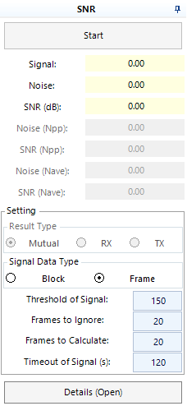
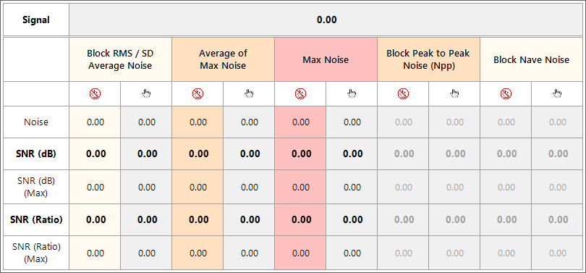
UI (1/3)
Threshold to divide signal & noise
After time of setting, it will get data
as signal directly
Detail is only for engineer

Slide 3
UI (2/3)
Results of Npp/Nave are only useful for Block of Signal type.

Slide 4
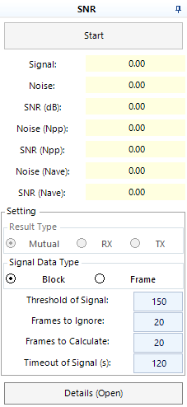
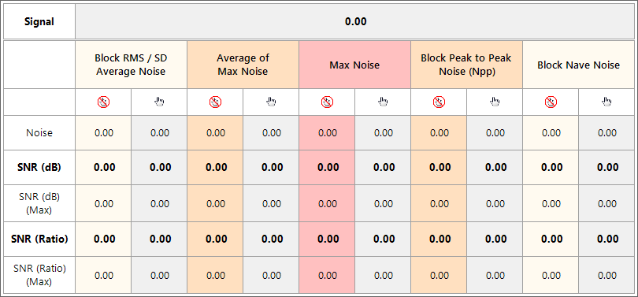
UI (3/3)
Results of Npp/Nave are only useful for Block of Signal type.

Slide 5
Data Collection – Noise Un-Touched
Threshold
Noise frames
Ignored frames
Signal frames
It caches noise frames to calculate a base data.
Noise and signal data are subtracted base data from Raw Data.
The data is divided into signal and noise by threshold.
The threshold of noise and signal can be modified.
The data frames and ignored frames can be modified.

Slide 6
Data Collection – Noise Touched
Threshold
Base frames
Ignored frames
Noise/Signal frames
It caches un-touched frames to calculate a base data.
Signal data is subtracted base data from Raw Data.
Signal data and un-touched data are separated from threshold.
Noise data is subtracted the average data of signal data.
The threshold of un-touched data and signal can be modified.
The data frames and ignored frames can be modified.

Slide 7
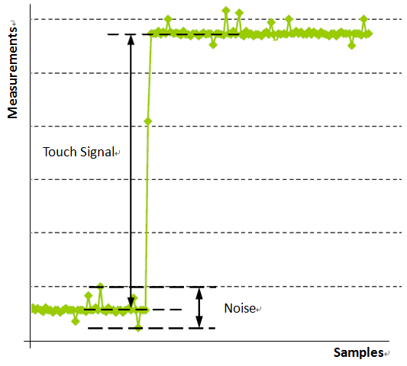
Data Collection
Noise Touched
Un-Touched

Slide 8
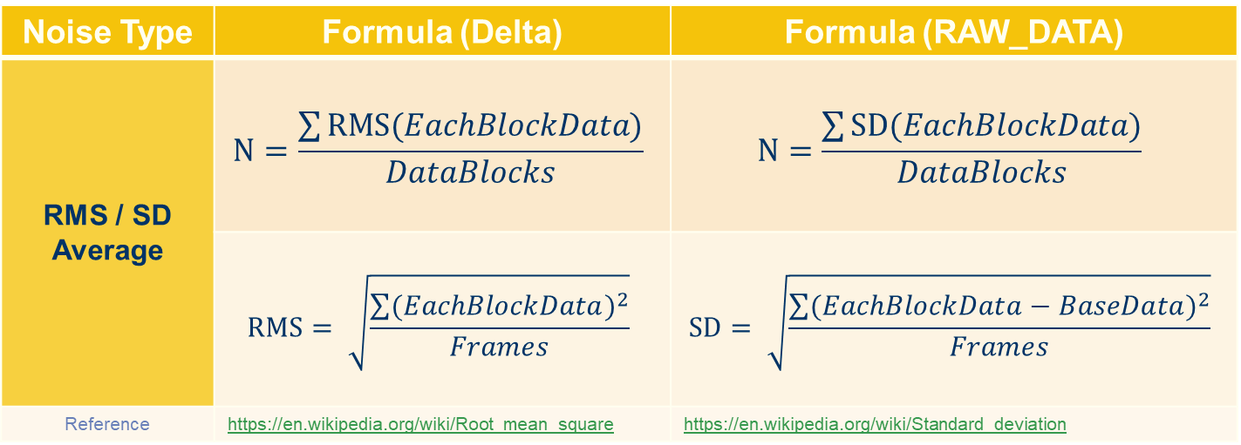
Signal-to-noise Ratio – Noise (1/2)
Noise Type | Formula (Delta) | Formula (RAW_DATA)
RMS / SD Average | $$\text{N}=\frac{\sum{\text{RMS}(EachBlockData)}}{DataBlocks}$$ | $$\text{N}=\frac{\sum{\text{SD}(EachBlockData)}}{DataBlocks}$$
 | $$\text{RMS}= \sqrt{\frac{\sum{{(EachBlockData)}^{2}}}{Frames}}$$ | $$\text{SD}= \sqrt{\frac{\sum{{(EachBlockData−BaseData)}^{2}}}{Frames}}$$
Reference | https://en.wikipedia.org/wiki/Root_mean_square | https://en.wikipedia.org/wiki/Standard_deviation

Slide 9


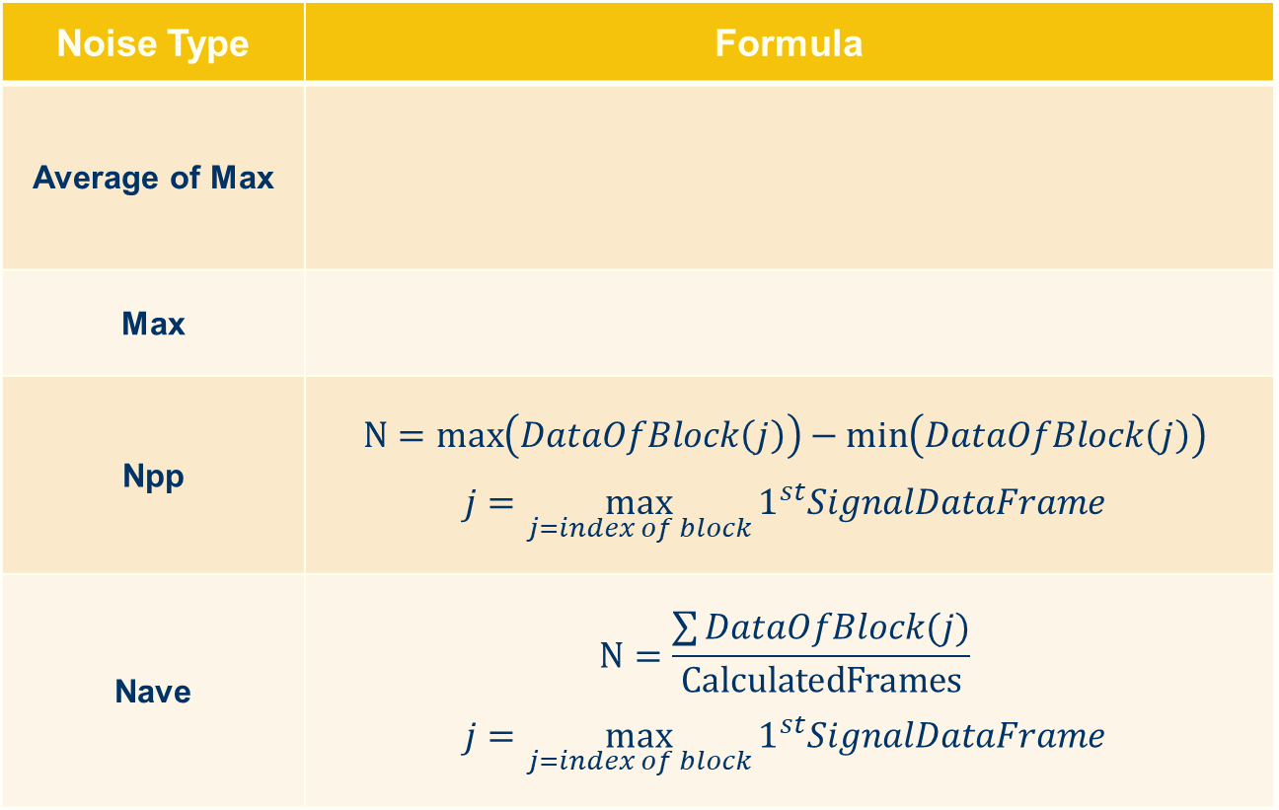
Signal-to-noise Ratio – Noise (2/2)
Noise Type | Formula
Average of Max
Max
Npp | $$\text{N}=\max\left(DataOfBlock\left(j\right)\right)−\min\left(DataOfBlock\left(j\right)\right)$$ $$j=\max_{j=index of block}{1^{st}SignalDataFrame}$$
Nave | $$\text{N}=\frac{\sum{DataOfBlock(j)}}{\text{CalculatedFrames}}$$ $$j=\max_{j=index of block}{1^{st}SignalDataFrame}$$
* Data from Raw data may be subtracted base data.

Slide 10
Example: Raw Data(SD) Noise(1/3)
Step 1: Calculate basedata from untouched n frames
basedata =
frame 1
frame 2
frame n
10 | 10 | 10
10 | 10 | 10
10 | 10 | 10
10 | 10 | 10
10 | 11 | 10
10 | 10 | 10
10 | 10 | 10
10 | 9 | 10
10 | 10 | 10
。。。
Basedata frame
BD0,0 | BD1,0 | BD2,0
BD0,1 | BD1,1 | BD2,1
BD0,2 | BD1,2 | BD2,2
(
10
10
。。。
10
) / n = BD0,0
(
。。。
9
) / n = BD1,1
10
11

Slide 11
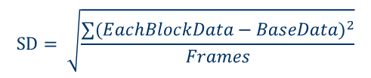
Example: Raw Data(SD) Noise(2/3)
Step 2: Calculate SD for each blocks within n frames.
Basedata frame
BD0,0 | BD1,0 | BD2,0
BD0,1 | BD1,1 | BD2,1
BD0,2 | BD1,2 | BD2,2
frame 1
frame 2
frame n
10 | 10 | 10
10 | 10 | 10
10 | 10 | 10
10 | 10 | 10
10 | 11 | 10
10 | 10 | 10
10 | 10 | 10
10 | 9 | 10
10 | 10 | 10
$$\text{SD}= \sqrt{\frac{\sum{{(EachBlockData−BaseData)}^{2}}}{Frames}}$$
。。。
SD frame
2
2
(
2
SD0,0 | SD1,0 | SD2,0
SD0,1 | SD1,1 | SD2,1
SD0,2 | SD1,2 | SD2,2
)
)
)
(
(
)/n = SD0,0
(
10
BD 0,0
10
BD 0,0
。。。
10
BD 0,0
2
2
(
2
(
)
)
)
) / n = SD1,1
(
10
BD 1,1
11
BD 1,1
。。。
9
BD 1,1

Slide 12
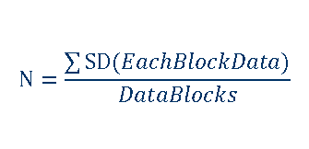
Example: Raw Data(SD) Noise(3/3)
Step 3: Calculate SD Avg.(Noise) by SD frame.
SD frame
SD0,0 | SD1,0 | SD2,0
SD0,1 | SD1,1 | SD2,1
SD0,2 | SD1,2 | SD2,2
$$\text{N}=\frac{\sum{\text{SD}(EachBlockData)}}{DataBlocks}$$
(
SD0,0
SD0,1
SD2,2
) / 9 = SD AVG(N).
。。。

Slide 13
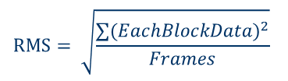
Example: IIR(RMS) Noise(1/2)
Step 1: Calculate RMS within n frames of each blocks.
frame 1
frame 2
frame n
10 | 10 | 10
10 | 10 | 10
10 | 10 | 10
10 | 10 | 10
10 | 11 | 10
10 | 10 | 10
10 | 10 | 10
10 | 9 | 10
10 | 10 | 10
$$\text{RMS}= \sqrt{\frac{\sum{{(EachBlockData)}^{2}}}{Frames}}$$
。。。
RMS frame
RMS0,0 | RMS1,0 | RMS2,0
RMS0,1 | RMS1,1 | RMS2,1
RMS0,2 | RMS1,2 | RMS2,2
(
2
2
2
10
10
。。。
10
) / n = RMS0,0
(
2
2
。。。
9
2
) / n = RMS1,1
10
11

Slide 14
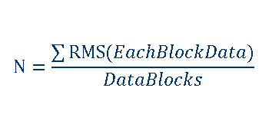
Example: IIR(RMS) Noise(2/2)
Step 2: Calculate RMS Avg.(Noise) by RMS frame.
RMS frame
RMS0,0 | RMS1,0 | RMS2,0
RMS0,1 | RMS1,1 | RMS2,1
RMS0,2 | RMS1,2 | RMS2,2
$$\text{N}=\frac{\sum{\text{RMS}(EachBlockData)}}{DataBlocks}$$
(
RMS0,0
RMS0,1
RMS2,2
) / 9 = RMS AVG(N).
。。。

Slide 15
Example: Average of Max Noise
frame 1
frame 2
frame n
12 | 10 | 10
10 | 10 | 10
10 | 10 | 10
10 | 10 | 10
10 | 11 | 10
10 | 10 | 10
10 | 10 | 10
10 | 9 | 10
10 | 10 | 12
。。。
(
12
11
。。。
12
) / n = Average of Max

Slide 16
Example: Max Noise
frame 1
frame 2
frame n
12 | 10 | 10
10 | 10 | 10
10 | 10 | 10
10 | 10 | 10
10 | 11 | 10
10 | 10 | 10
10 | 10 | 10
10 | 9 | 10
10 | 10 | 10
。。。
12
= Max

Slide 17



Signal-to-noise Ratio – Signal
Signal Type | Formula
Frame
Block
* Data from Raw data may be subtracted base data.
Notes:
Type Block Fomula說明:
j = 第一張 frame 最大值位置, 後續 frame 取固定位置

Slide 18
Example: Frame Signal(1/2)
Step 1: Calculate basedata from untouched n frames
basedata =
frame 1
frame 2
frame n
10 | 10 | 10
10 | 10 | 10
10 | 10 | 10
10 | 10 | 10
10 | 11 | 10
10 | 10 | 10
10 | 10 | 10
10 | 9 | 10
10 | 10 | 10
。。。
Basedata frame
BD0,0 | BD1,0 | BD2,0
BD0,1 | BD1,1 | BD2,1
BD0,2 | BD1,2 | BD2,2
(
10
10
。。。
10
) / n = BD0,0
(
。。。
9
) / n = BD1,1
10
11

Slide 19
Example: Frame Signal(2/2)
frame 1
Basedata frame
frame 2
frame n
BD0,0 10 | BD1,0 10 | BD2,0 10
BD0,1 11 | BD1,1 11 | BD2,1 11
BD0,2 12 | BD1,2 12 | BD2,2 12
18 | 10 | 10
10 | 10 | 10
10 | 10 | 10
10 | 10 | 10
10 | 17 | 10
10 | 10 | 10
10 | 10 | 10
10 | 9 | 10
10 | 10 | 18
。。。
Basedata frame
Basedata frame
Basedata frame
frame 1’
frame 2’
frame n’
8 | 0 | 0
-1 | -1 | -1
-2 | -2 | -2
0 | 0 | 0
-1 | 7 | -1
-2 | -2 | -2
0 | 0 | 0
0 | -1 | 0
-2 | -2 | 6
。。。
(
8
7
。。。
6
) / n = S

Slide 20
Example: Block Signal
frame 1
frame 2
frame n
Basedata frame
BD0,0 10 | BD1,0 10 | BD2,0 10
BD0,1 11 | BD1,1 11 | BD2,1 11
BD0,2 12 | BD1,2 12 | BD2,2 12
18 | 10 | 10
10 | 10 | 10
10 | 10 | 10
10 | 10 | 10
10 | 17 | 10
10 | 10 | 10
10 | 10 | 10
10 | 9 | 10
10 | 10 | 18
。。。
(Subtract basedata frame)
Basedata frame
Basedata frame
Basedata frame
frame 1’
frame 2’
frame n’
8 | 0 | 0
-1 | -1 | -1
-2 | -2 | -2
0 | 0 | 0
-1 | 7 | -1
-2 | -2 | -2
0 | 0 | 0
0 | -1 | 0
-2 | -2 | 6
。。。
(
8
0
。。。
0
) / n = S

Slide 21
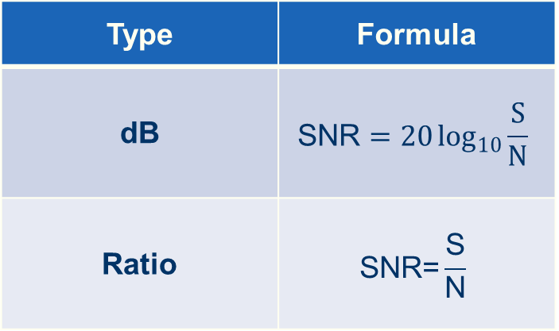
Signal-to-noise Ratio – SNR
Type | Formula
dB | $$\text{SNR}=20\log_{10}{\frac{S}{N}}$$
Ratio | $$\text{SNR}\text{=}\frac{\text{S}}{\text{N}}$$

Slide 22

Drive for better vision

Slide 23

SNR Calculation Formula

